Slide 1

Gain Perspective
Team Baby Shark Doo Do:
Aditya Chandrashekhar
Khush Kothari
Vedula Kartikeya
Meenakshi Sundaram Siddharth

Slide 2
Introduction: TOXICITY on social media
Toxicity on social media refers to comments adhering to racism, sexism, homophobia, promoting unrealistic body standards, creating online drama and a plethora of such things.
Such disrespectful environment can create negativity and unnecessary hatred among people.
People fail to understand the main purpose of social media i.e., better communication.
Social media becomes a “hub of trolling” wherein people have the confidence to wrongly target any random person on the platform with whom they are least likely to meet in real life

Slide 3
Introduction: Misinformation on social media
Irrespective of the credibility of the news article, readers are always attracted towards misinformation.
Recent studies show that on an average, there are five times as many people who read the headline when compared to the body of an article. This means that people can use headline as a tool to market (their) fake news.
Apart from the headline, people might find the article enticing enough to spread it around rather than taking a step to check the credibility of the article.

Slide 4
GAIN perspective
Our team: Baby Shark doo doo envisions to bring down the levels of toxicity and misinformation on social media platforms.
Gain Perspective is an extension on google chrome which serves the following purposes:
On taking input from the user, we find out the sentiment of the text.
If sentiment is negative, the machine learning algorithm will classify it into either of the 6 categories:
Toxic, Severe toxic, Obscene, Threat, Insult and Identity hate.
Furthermore, we analyse the text and suggest relevant articles.
Relevant articles are suggested to educate the person on the topic. An additional advantage is that no extra effort is required to check the truthfulness of the article. This is because relevant articles are shown from credible sources like BBC, CNN, etc.

Slide 5
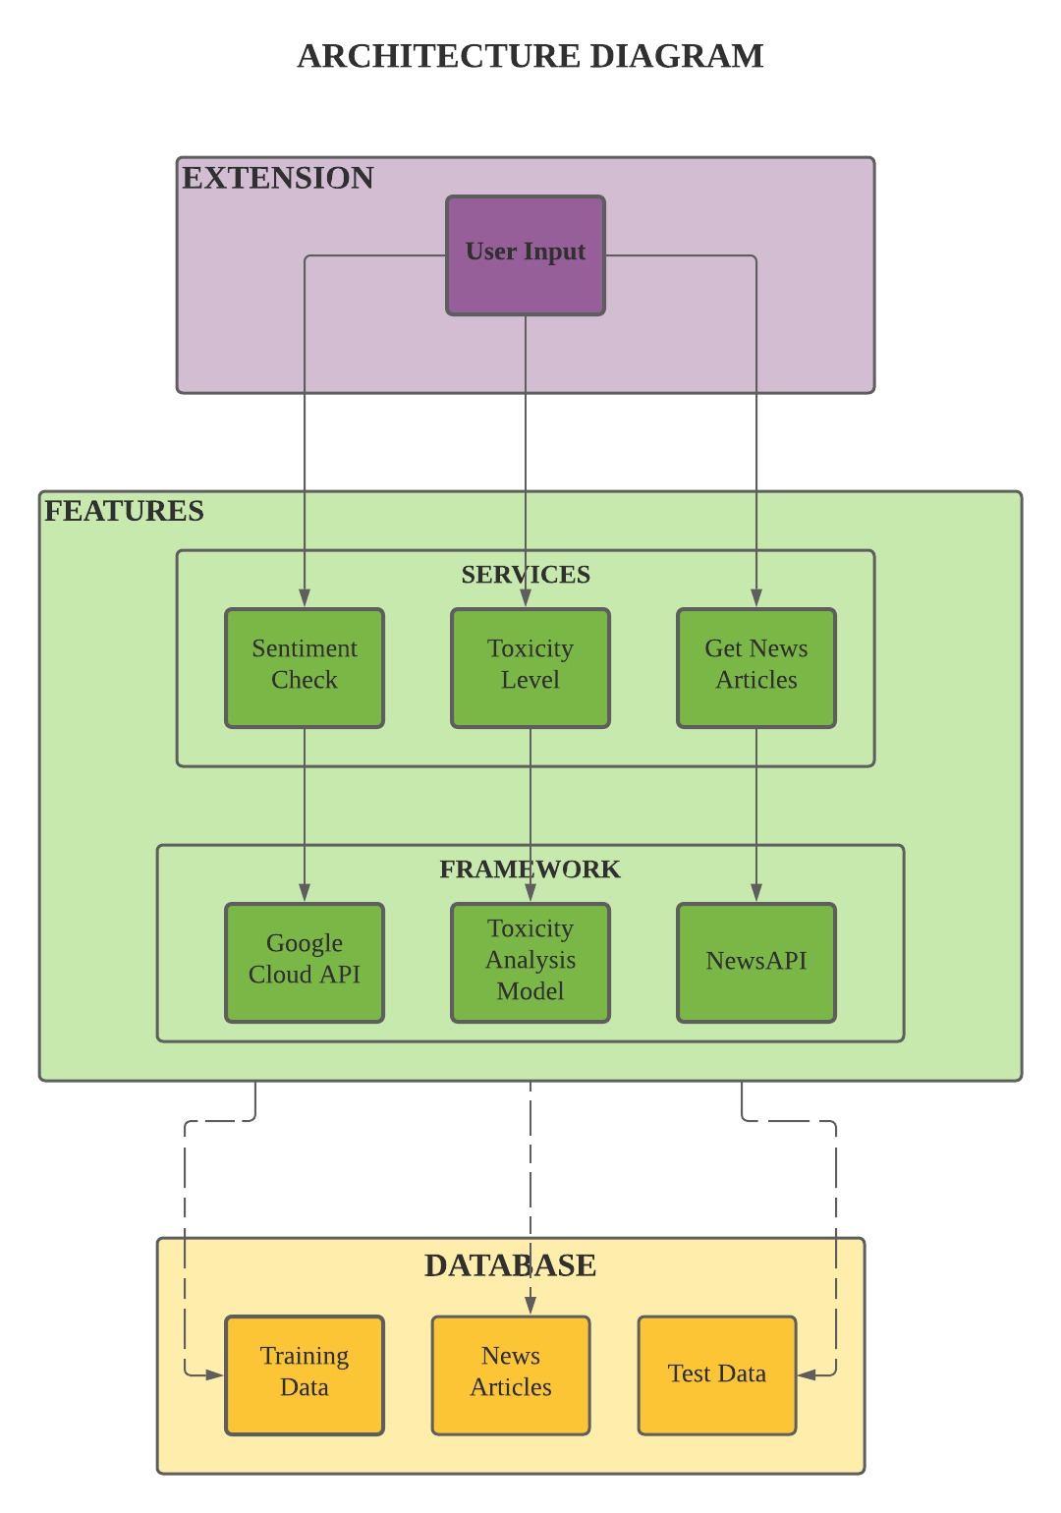
Candidate architecture diagram

Slide 6
Live demo

Slide 7
Thank you for your time ☺

